Slide 1
Modelling the Solid Hardwood Supply Chain Network With Quality Function Deployment (QFD)
Project Meeting EU-Hardwoods
University of Natural Resources and Life Sciences, Vienna
Dipl.-Ing. Sebastian Kühle (FH)
Institute of Wood Technology and Renewable Materials
Alfred Teischinger
1. Supervisor, Department of Material Science and Process Engineering, BOKU
Manfred Gronalt
2. Supervisor, Insitute of Production and Logistics, BOKU

Slide 2
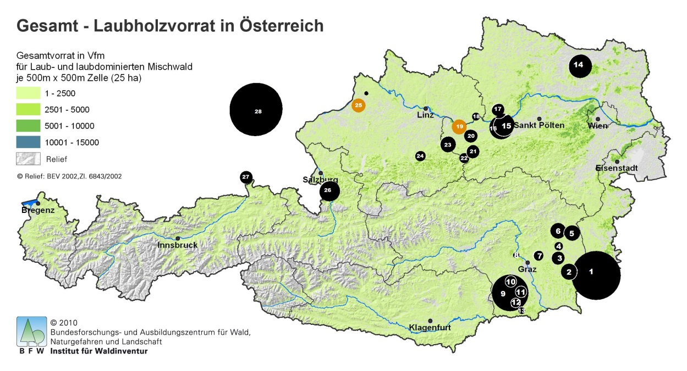
Introduction
Customer
Product
Supply Chain
Process Chains
Technology
Source:
Holzkurier 2013/7
Notes:
Demand-driven markets today
How? When we focusing on the resource?
SCN is a system of procurement-production-distribution facilities, where material and information flow within and across organizational boundaries through intertwined business networks of suppliers, producer and distributors to final customers.

Slide 3
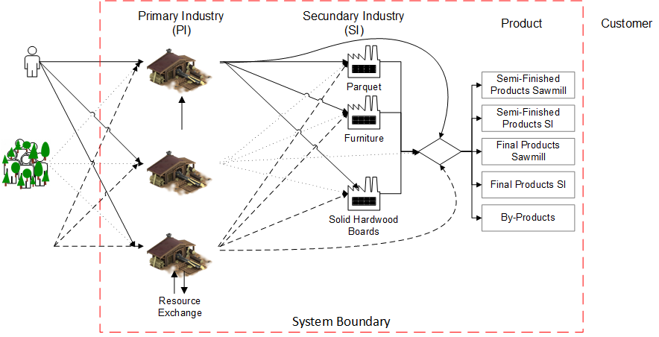
The Network
Resource

Slide 4
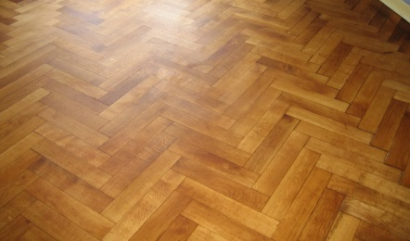
Quality Function Deployment Voice of Customer
House of Quality I
House of Quality „Voice of Customer“ Phase 1
4: How vs. How
Which conflicts exisit between the characteristics?
3: How
Quality Parameter Product Characteristic
1: What Voice of Customer
Customer Relevance (Scale 1-5)
5: What vs. How
Correltaion Matrix
How much effects the characteristic the requirements? (Scale 0-9)
2: Why
Evaluation of competitors
(Rating Scale 0-1-3-9)
6: How much
Determine of Objectives
Priority of How (Results)
Source: Saatweber,J. (2007): Kundenorientierung durch QFD.
Notes:
QFD has been defined in many different ways. QFD is a structured process, a visual
language, and a set of inter-linked engineering and management charts, which uses the seven
management (new) tools. It establishes customer value using the voice of the customer and
transforms that value to design, production, and manufacturing process characteristics. The result
is a systems engineering process, which prioritizes and links the product development process so
that it assures product quality as defined by the customer/user

Slide 5
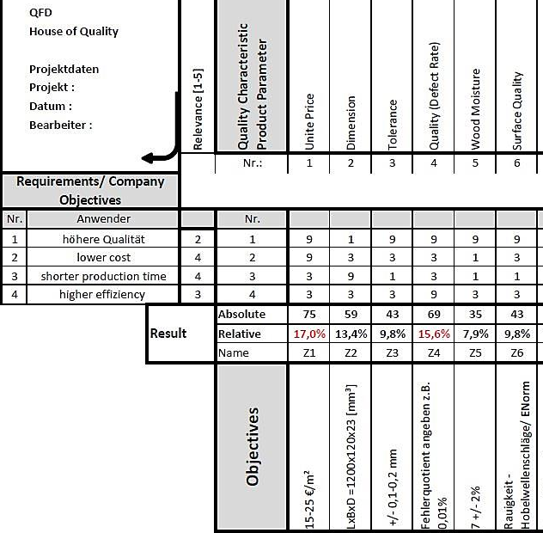
Quality Function Deployment Voice of Customer
House of Quality I
House of Quality „Voice of Customer“ Phase 1
4: How vs. How
Which conflicts exisit between the characteristics?
1
3
3: How
Quality Parameter Product Characteristic
higher quality
1: What Voice of Customer
Customer Relevance (Scale 1-5)
5: What vs. How
Correltaion Matrix
How much effects the characteristic the requirements? (Scale 0-9)
2: Why
Evaluation of competitors
4
2
6: How much
Determine of Objectives
Priority of How (Results)
Source: Saatweber,J. (2007): Kundenorientierung durch QFD.
Notes:
QFD has been defined in many different ways. QFD is a structured process, a visual
language, and a set of inter-linked engineering and management charts, which uses the seven
management (new) tools. It establishes customer value using the voice of the customer and
transforms that value to design, production, and manufacturing process characteristics. The result
is a systems engineering process, which prioritizes and links the product development process so
that it assures product quality as defined by the customer/user

Slide 6
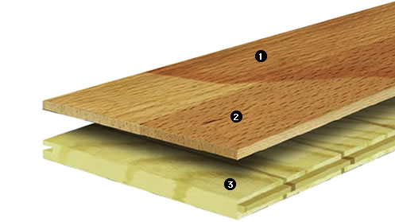
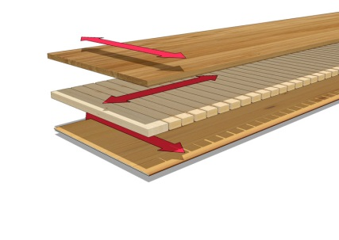
Multi-Step Approach
HoQ II
HoQ III
Product characteristics from the HoQ I as Input
Several Components
Functions
Material characteristics
Components characteristics from the HoQ II as Input
Process Chains & Elements
Manufacture characteristics
Specific amount or time

Slide 7
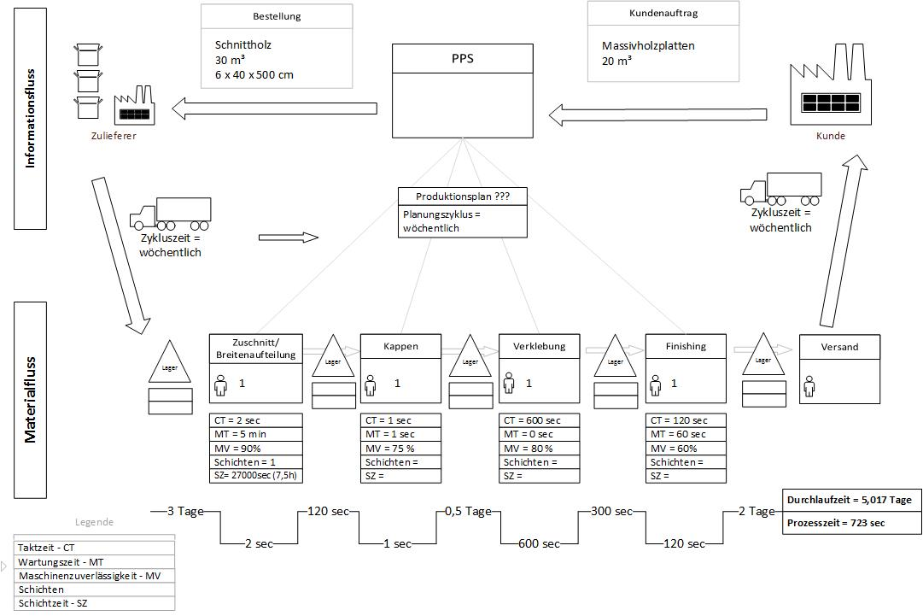
Specific Data
HoQ IV
Value Stream Mapping
Advantages:
Visualisation of the Material Flow
Record of Specific Data
Record of Process Chains
Detailed Information about Key Processes

Slide 9
QFD and the 4 „Houses of Quality“
1. QFD Phase Product Planning
2. QFD Phase Components Planning
3. QFD Phase Production Planning
4. QFD Phase Specific Data
HoQ I
HoQ II
HoQ III
HoQ IV
Conventional use as product development tool
Innovative use as information providing tool
Notes:
AHP – Analytic Hierarchical Process

Slide 10
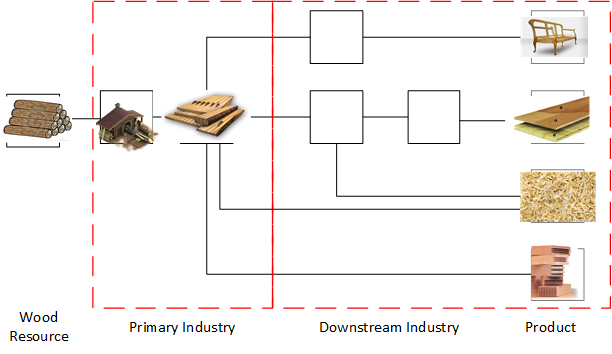
Covered Areas
Received Information:
Process Chains and Elements
Actual Used Technology
Specific Data and Process Data
Amount of Resource
Production Capacity
Yields
Costs
Customer
QFD
VSM
Expert Interview
Product
Process
Inter-company Links

Slide 11
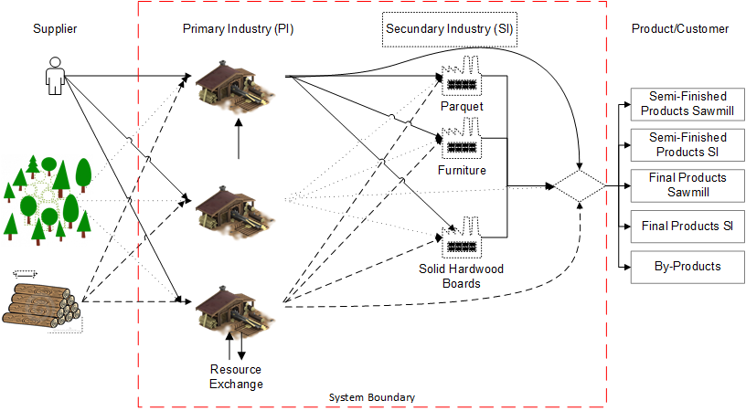
Preliminary Results
System Boundary

Slide 12
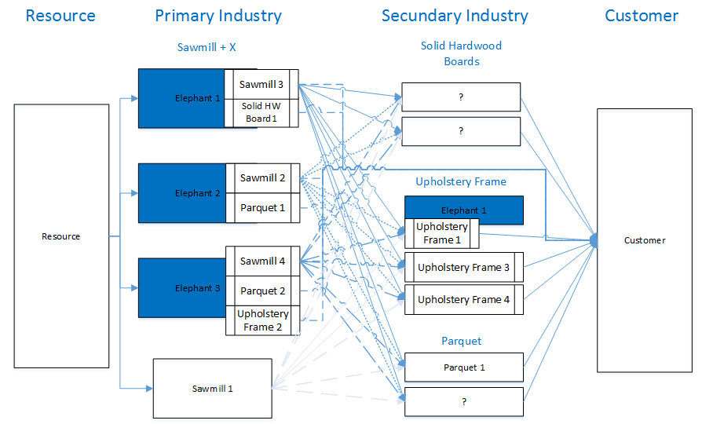

Slide 13
Process Chains & Elements
Sawmill
Parquet
Solid Hardwood Board
Upholstery Frames

Slide 14
Conclusion
Qualitative procedure development
Individual consideration of business networks
Consideration of customer requirements with products characteristics
Structured process of collecting information
Transparency of business network process chains

Slide 15
Further Steps
Finishing the analysis of the SCN
Better links between intermediate and final product
Analyse redundancy in supply chain processes
Analyse underuse capacities
Find cooperation potential
Cooperation with secondary industry
Ultimate Objective
Optimised Supply Chain Network Model
Mathematical Model
Linear Programming
Notes:
In addition to the typical timber assortment
There are many challenges which have to be solved. From which direction and with which point of view you start belongs to you and the scientific field you are working.
What about collaboration?

Slide 16
Acknowledgment
Financial support for this work in the framework of the PhDSchool DokIn´Holz funded by the Austrian Federal Ministry of Science, Research and Economy as well as the Austrian Federal Forestry and the Austrian Chamber of Agriculture are gratefully acknowledged.

Slide 17
Everyone a pleasant day.
Dipl.-Ing. Sebastian Kühle (FH)
PhD Student, BOKU
Institute of Wood Science and Technology
Konrad Lorenz Straße 24, A-3430 Tulln an der Donau
Contact: skuehle@boku.ac.at

Slide 18
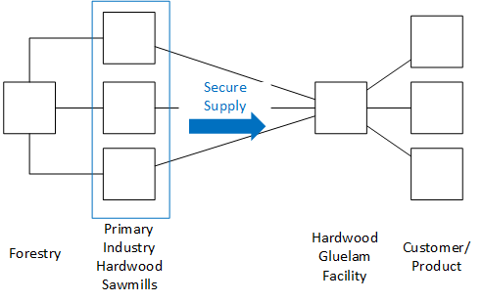
Meeting Input Strategic Analysis
Relevant Information:
Process Chains and Elements
Actual Used Technology
Specific Data and Process Data
Amount of Resource
Production Capacity
Yields
Cutting Patterns
Divergent Material Flow
Co-Products

Slide 19
Case Study Switzerland
2009 Analysis of the hardwood sawmills
Missing link and industry in the supply chain for value added products
2013 Final report: Hardwood manufacturing in the north-west of Switzerland
Feasibility study and cost estimation (technology, tests, layout planning, markets, …)
Products:
Hardwood sawnwood, solid hardwood boards
Hardwood + hybrid construction boards, GL Beams, CLT
2014 Test report: Mechanical properties of Beech CLT
2014 - 2017 Building facility – Fagus Jura AG
2015 Workshop for collecting of the current knowledge:
Glulam made of Beech and connections in Beech glulam
Source: 1) CH-2009-Analyse der Schweizer Laubholz Sägewerke
2) CH-2013-Schlussbericht-Laubholzverarbeitung Nordwestschweiz
3) Franke et al. (2014): Mechanische Eigenschaften von Buchen –Brettsperrholz. Berner Fachhochschule.
4) Steiger-Franke-Frangi-2015-CH-Projektbericht-Brettschichtholz-Buche

Slide 20
Fagus Jura AG
Source: 1) CH-2013-Schlussbericht-Laubholzverarbeitung Nordwestschweiz
2) Homepage: http://www.fagusjura.ch/home.html

Slide 21
Meeting Input Strategic Analysis
Supply Chain Network
How does it look like?
Structure analysis
Capacities?
Products lead to technology
Production and logistics concepts

Slide 22
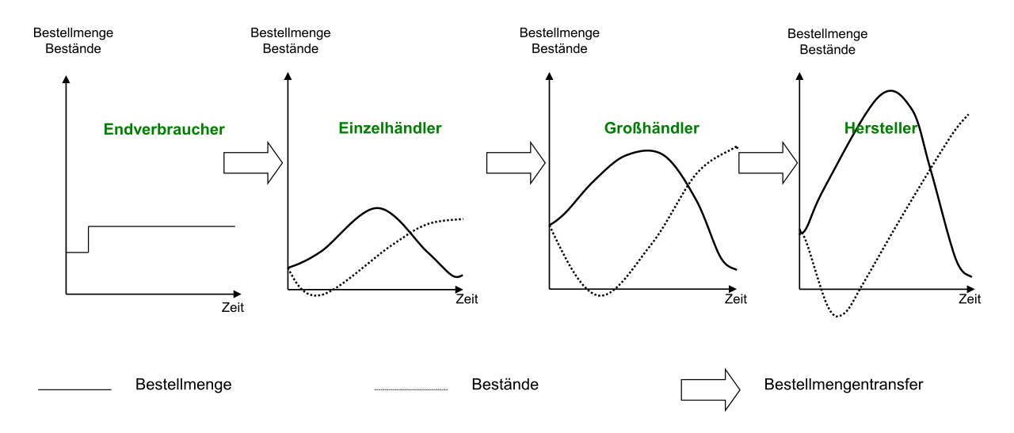
Bullwhip Effect - Theory
Forest
Sawmill
2nd Industry
Customer
Effects
Increased inventory due to disproportionate stoackage,
Worse customer service,
Irregular capacity utilisation,
Unsatisfactory product quality,
Increased labour cost due to overtime and
Loss of profit of the involved SC members
Order Size Inventory
Order Size Inventory
Order Size Inventory
Order Size Inventory
Customer
2nd Industry
Sawmill
Forest
Time
Time
Time
Time
Order Size
Inventory
Source: 1) Bause, F.; Kaczmarek, M. (2001): Modellierung und Analyse von Supply Chains (WIRTSCHAFTSINFORMATIK, 43).
2)Simon, H. A. (1952): On the Application of Servomechanism.Theory to the study of Production Control. In. Econometrica 20, S. 247-268
3) Forrester, J. (1961): Industrial Dynamics a Major Breakthrough for Decision makers. In: Harvard Business Review 36(4), S. 37-66 4) Lee, H. L.; Padmanabhan, V.; Whang, S. (1997): Information Distortion in Supply Chain: Bullwhip Effect. In: Management Science (43), S. 546–558.

Slide 23
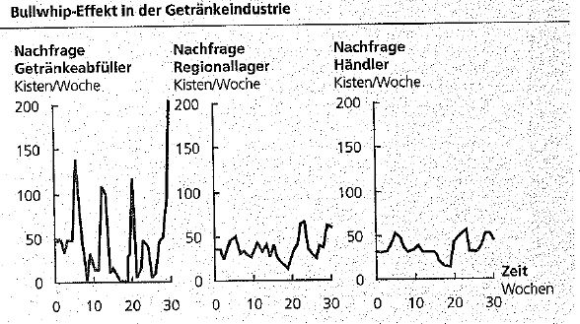
Bullwhip Effect - Practice
Causes
Demand distortion (ger.: Verzerrung der Nachfrage),
Inflated orders during shortage periods- rationing game (ger.: Rationierung und der Engpasspoker),
Order batching (ger.: Losgrößenbildung oder Sammelbestellungen),
Price fluctuation – forward buying (ger.: Preisvariationen)
Quelle: 1) Thonemann, Ulrich (2005): Operations Management. Konzepte, Methoden und Anwendungen. Kapitel 8 - Supply Chain Management: Perason Studium

Slide 24
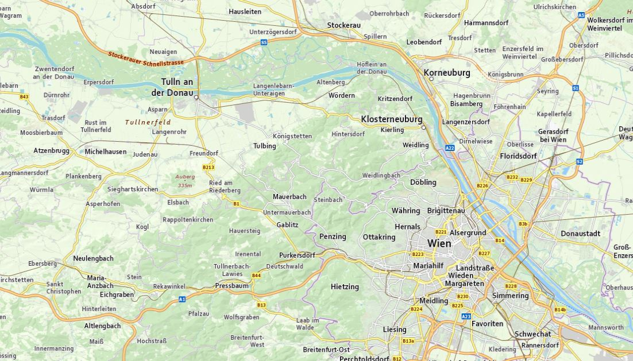
Work!(-Life-Balance)

